Slide 1

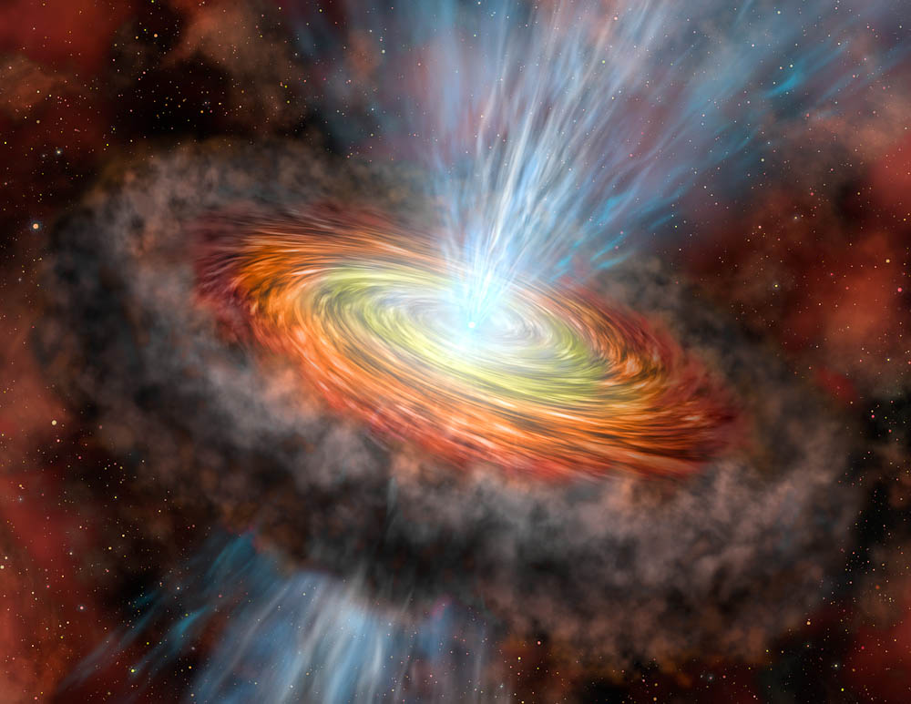
Simulations of instabilities in Accretion disk Torus
Jung Lin (Doris) Lee (UC Berkeley)
Kengo Tomida (Princeton)
Jim Stone (Princeton)
USRP Final Presentation, 08/06/2015
Image Credit: Gemini Observatory, Lynette Cook

Slide 2
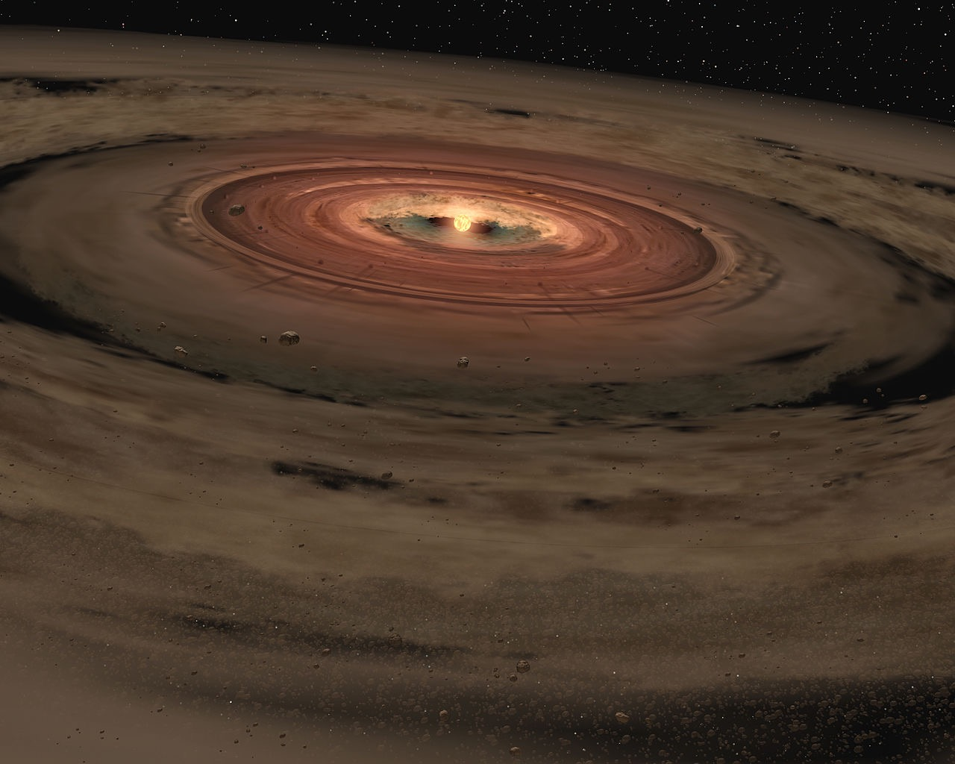

Accretion disks
in astrophysics
Example:
Protostellar discs
Supermassive Black Holes in AGNs
Mergers of neutron star binaries
Image Credit: NASA Jet Propulsion Lab
Notes:
L transport important for mass accretion onto central obj
Observational evidence : Jets, directly image HL tau ALMA
Theory → code / numerical schemes development

Slide 3
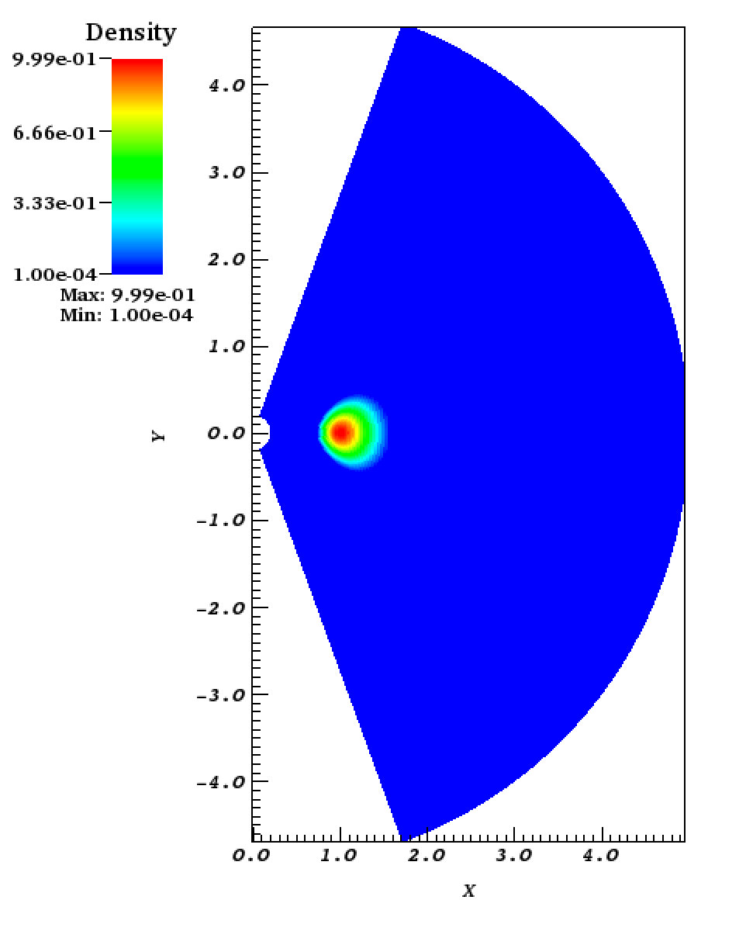
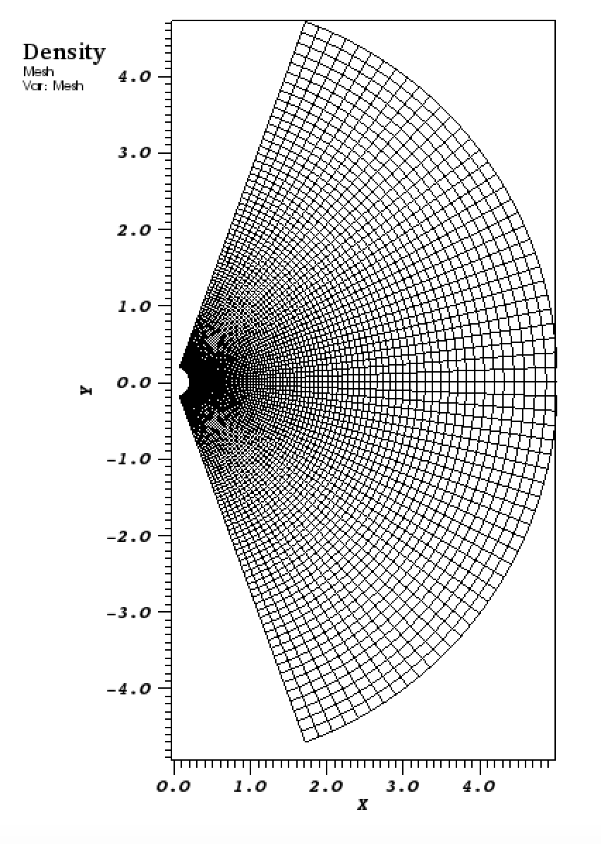
Tools for simulating accretion disk physics
Athena ++
Hydro: HLLC Solver
MHD: HLLD Solver
Radial Log-gridding
Static Mesh Refinement
Spherical polar coordinates
24~768 cores, MPI, NERSC
Notes:
pseudo-Newtonian Potential
- Log gridding factor 1.03 → ambient condition
- Numerical → suppress instability → High-Res

Slide 4

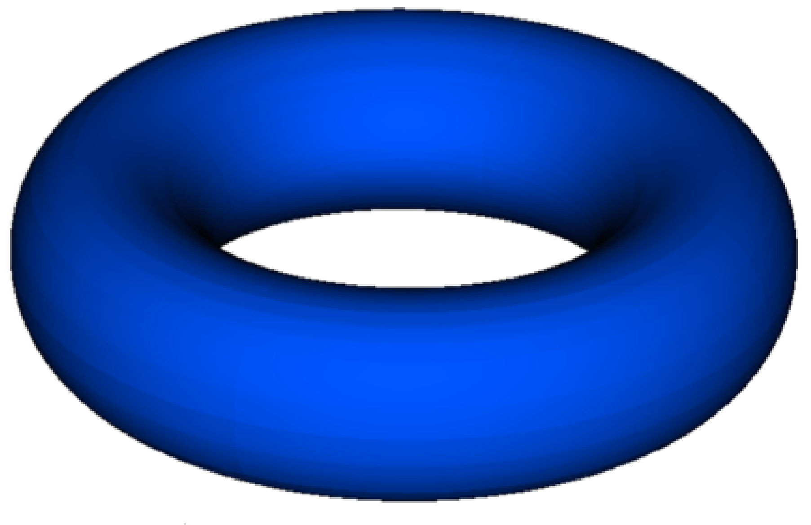

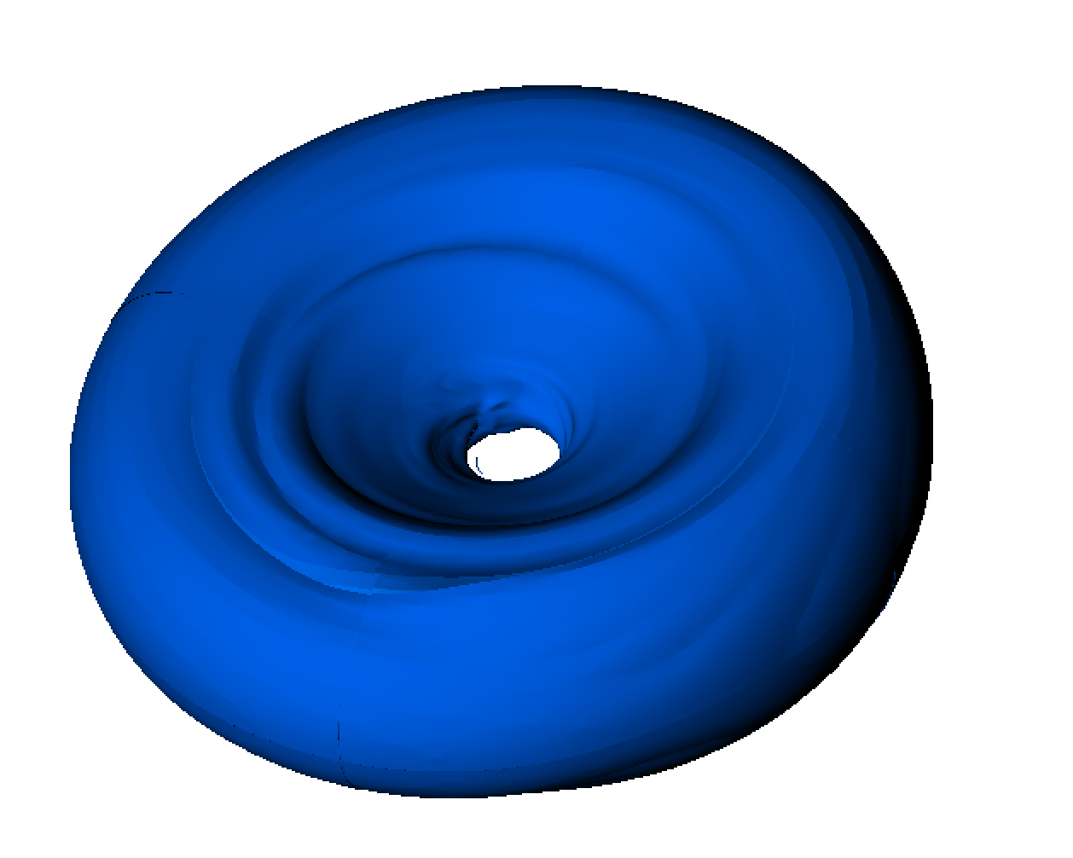
Papaloizou-Pringle Instability
hydrodynamic, global instability
constant angular momentum
Corotation amplification mechanism
Notes:
- PPI 1984 show tori unstable to non-axisymmetric global modes
-Initial condition: hydrostatic EQM
- rotational velocity profile constant angular momentum
global : not show up in local stability analysis (Rayleigh criterion)
Academic Interest: exist analytical sol’n
perfect test cases verify with Athena ++ code

Slide 5
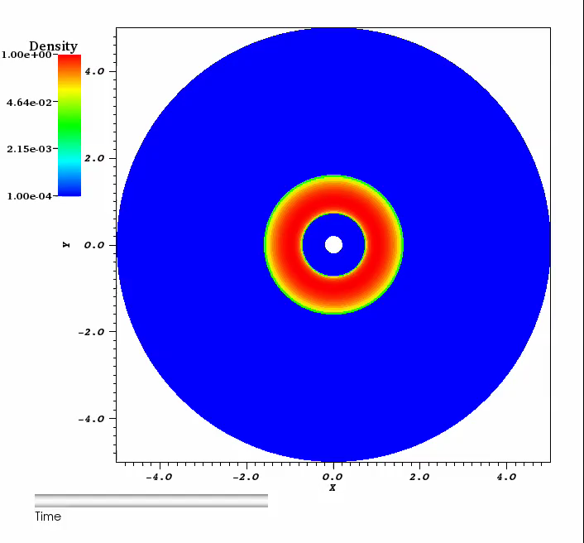
Simulation results
96x64x128
Notes:
- Perturbation: Eigenmode versus entropy in grid
hydrostatic EQM (just stay there)
- Even though instability kicks in at < 10 orbits, carry to nonlinear regime until the pressure maximum spiral into the innermost boundary to track evolution of torus
- Qualitatively, agree with isodensity contour Hawley

Slide 6
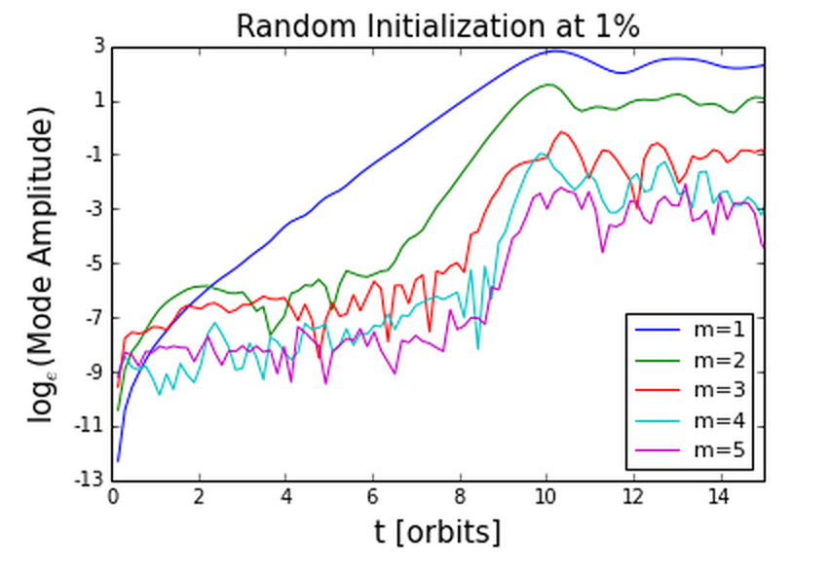
Mode Growth analysis
Notes:
- Integrated mass , Fourier decomposition along phi direction
dominant m=1 growth then mode coupling cause higher order mode to grow much faster
Computed mode growth, Agree with analytical and numerical prediction (GGN (1985), Hawley)
Before MRI, PPI was possible mechanism for generating turbulent viscosity for L transport. but no significant L trans.→ MRI

Slide 7
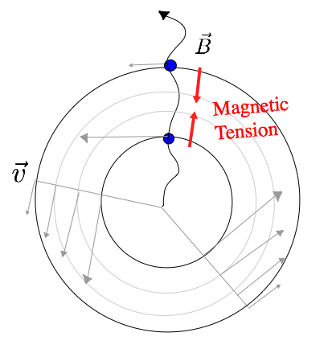
Magnetorotational instability (MRI)
Notes:
local, MHD instability (Balbus Hawley 1991)
now widely accepted to be the mechanism of L transport in ionized accretion disc.
initialized the same as PPI case, hydrostatic EQM rotating torus,
now + subthermal, poloidal magnetic field (set up by defining a A-phi)
we use the same velocity profile as the const angular momentum case, but not required for the instability to work (Keplerian V is okay)
Maxwell and Reynold stress of the turbulent state transport angular momentum outward, so gas accretion inward
although local instability, global simulation enable MRI to sample larger wavelength in r and phi

Slide 8
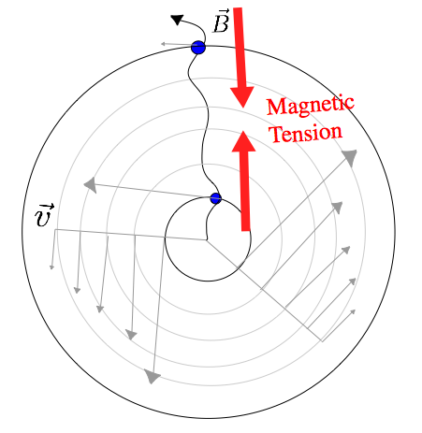
Run-away Instability

Slide 9
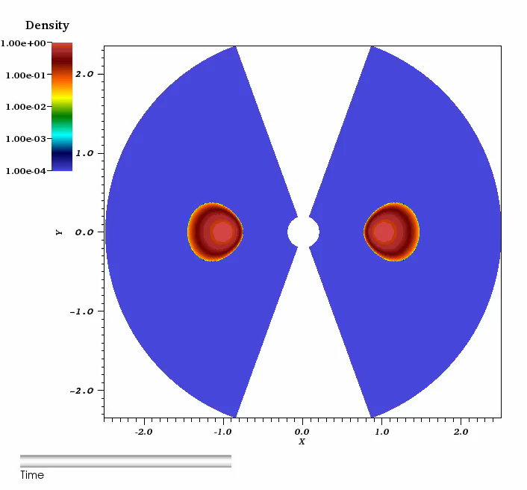
SIMULATION RESULTS
384x256x256
Notes:
timescale MRI>>PPI
MRI much faster, violent then PPI
r,θ ,phi resolution
need high resolution to resolve higher order mode → short λ

Slide 10
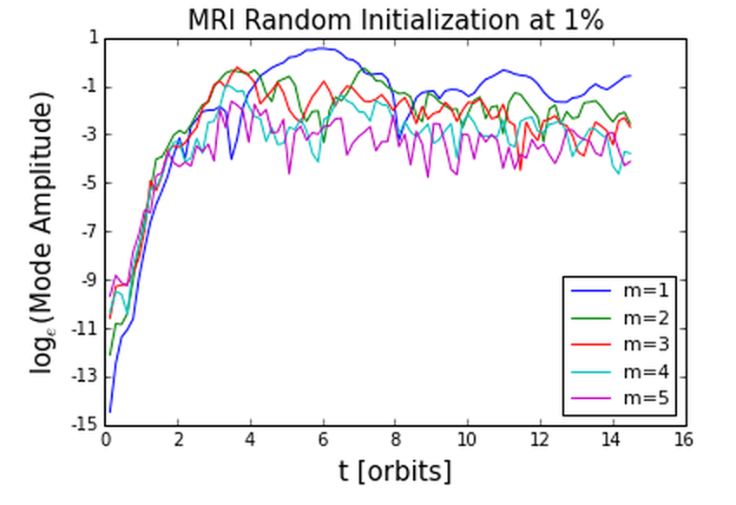
MRI Mode growth analysis
Notes:
Since the MRI is dominated by higher-order modes, it is crucial that our grids resolve to scales smaller than these in order for to resolve the higher order modes.
m=1 no longer dominant mode, other modes are comparable
- To resolve higher order modes in MRI we require much higher-res grid
→ 384x256x256 (768 cores→ ~15hrs) 27.4 orbits

Slide 11
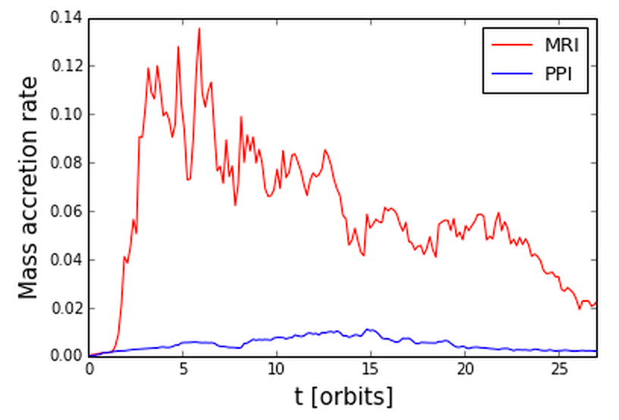
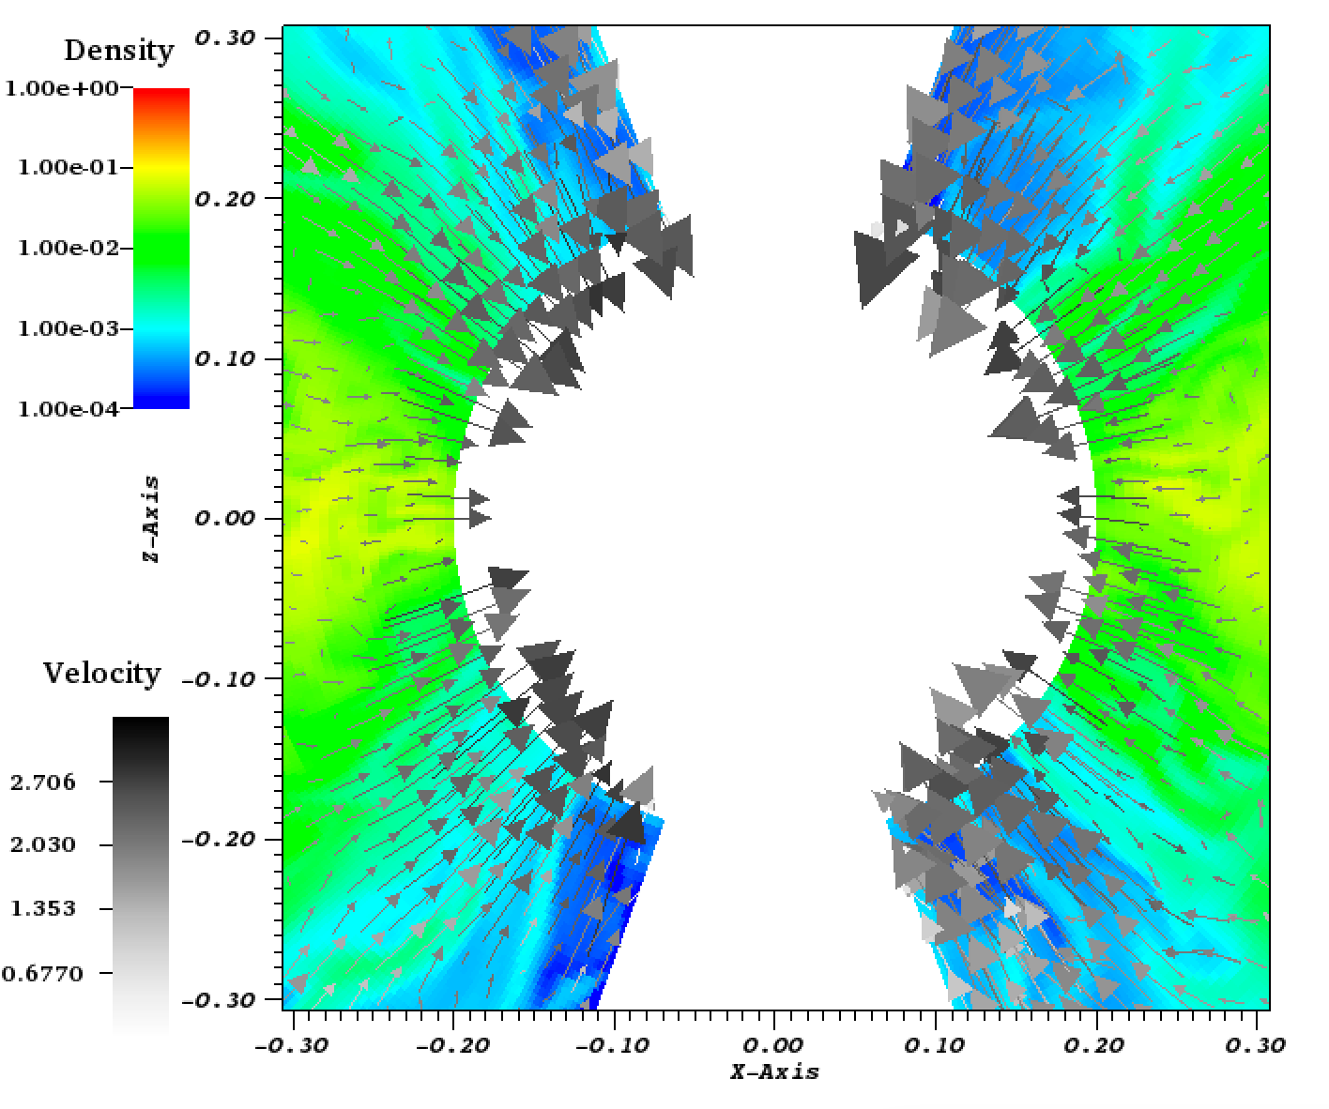
Mass accretion rate history
Notes:
- mass flux onto the inner radial boundary
Since angular momentum is conserved in sys, mass accretion rate roughly indicate angular momentum transport
MRI effective in outward angular momentum transport in disc

Slide 12
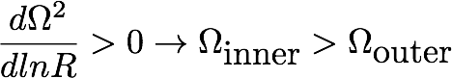
Summary
Papaloizou Pringle Instability | Magnetorotational Instability
Global, nonaxisymmetric, Hydrodynamical | Local, MHD
Constant Angular Momentum
m=1 mode dominant | higher order modes dominant
Provide angular momentum transport, but not as considerable as MRI. | Faster growth. More effective angular momentum transport .
Shearing
Notes:
Tested Athena ++ robust for simulating these types of instabilities in accretion discs
enabled us to verified with previous results (analytical and numerical)

Slide 13
Extra Slides

Slide 14
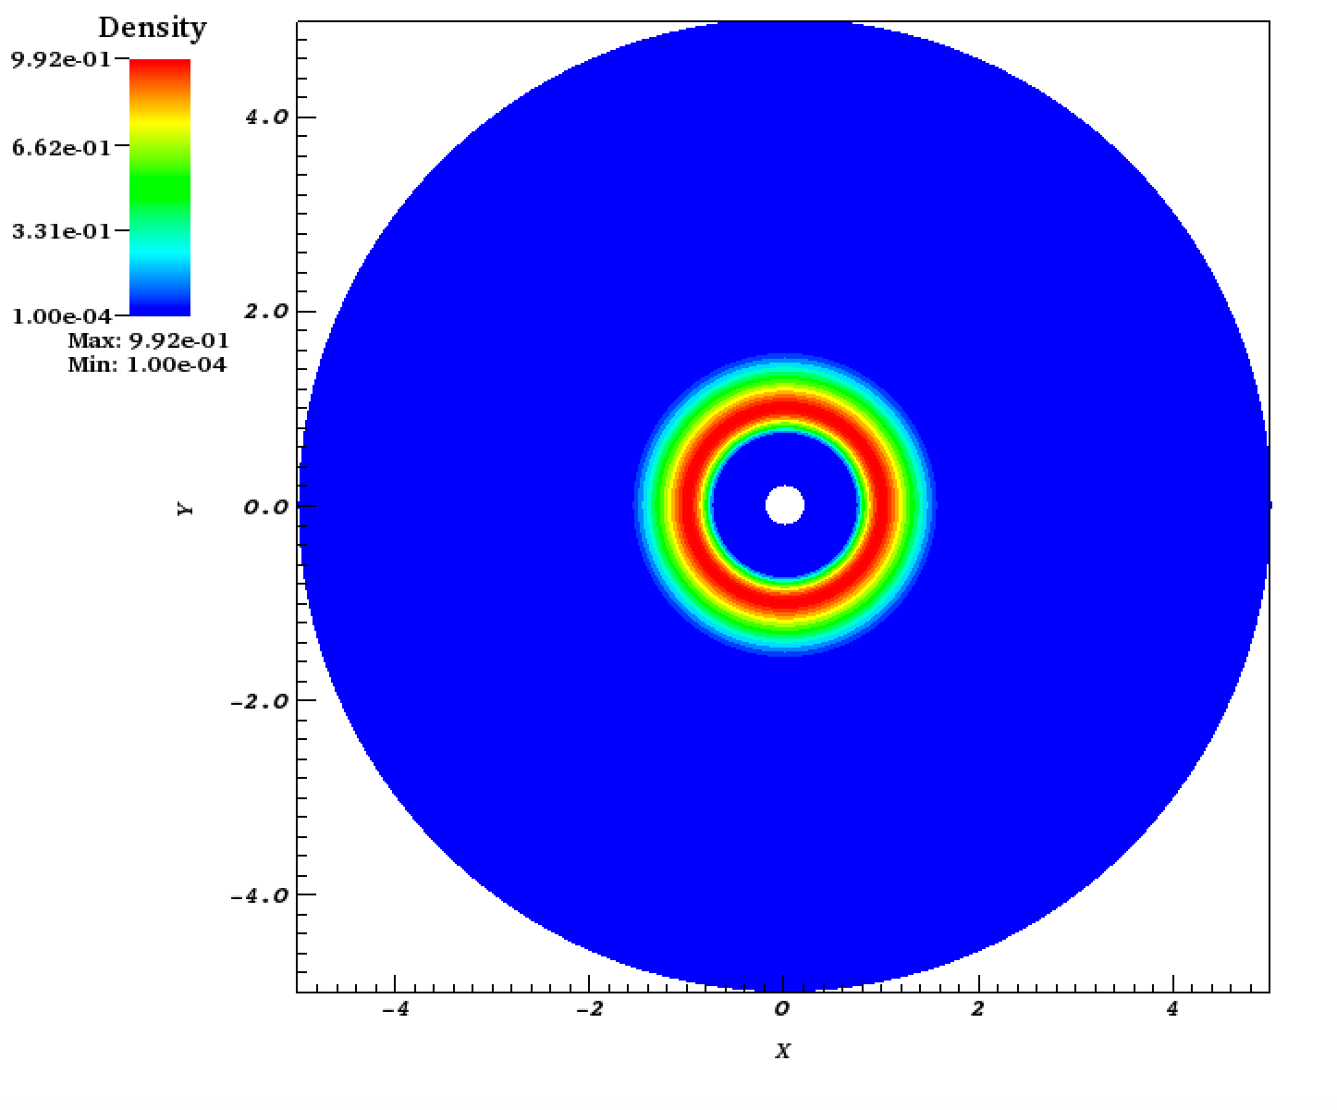
Simulation setup
Notes:
linear stability analysis analytical but non linear regime can only be studied with simulation
Accretion disk at Eddington Luminosity
Eddington Luminosity: radiation ≈ gravitational pressure
∵ radiation pressure at center ∴ disc → roughly toroidal shape
high internal temperature
→ ∇ P gets large enough so that not just Fc=Fg
→ deviation from Keplarian → Constant angular momentum
- β ≈ 400; Aphi = rho^2/ beta_0 → weak B(r,θ)

Slide 15
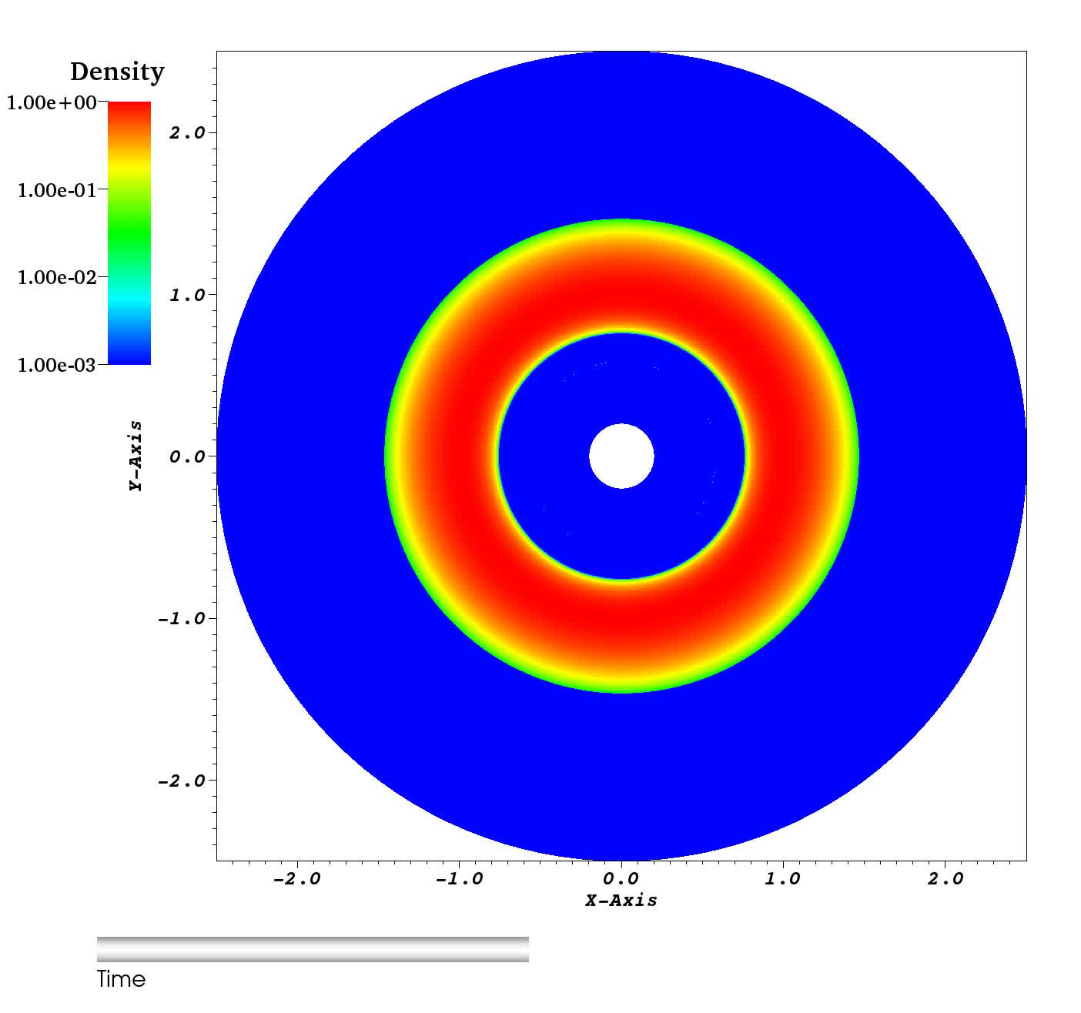
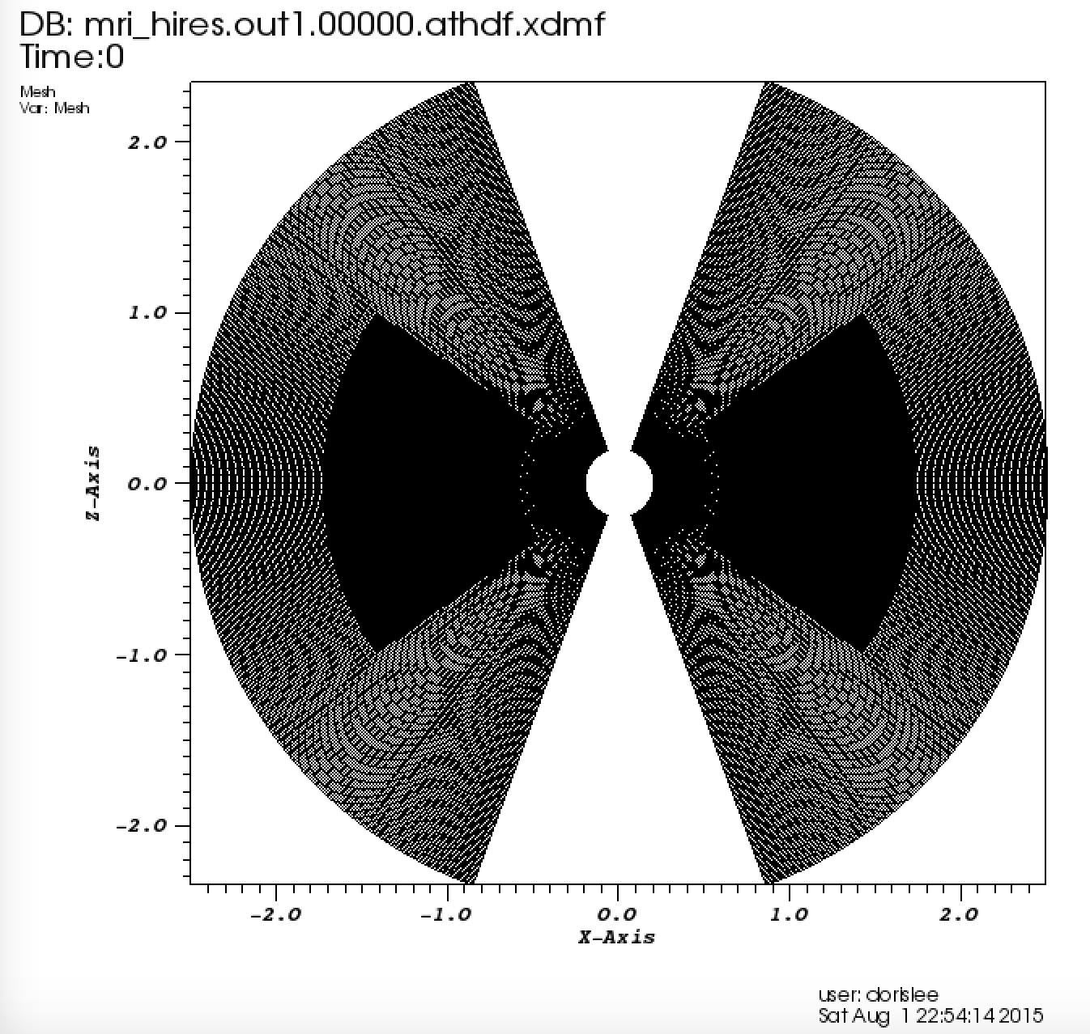
Static Mesh Refinement
192x128x128
Notes:
192x128x128
≈ 27 orbits

Slide 16
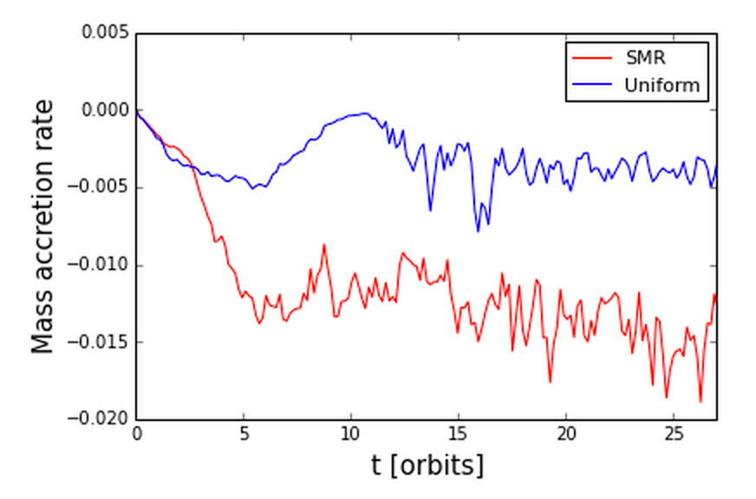
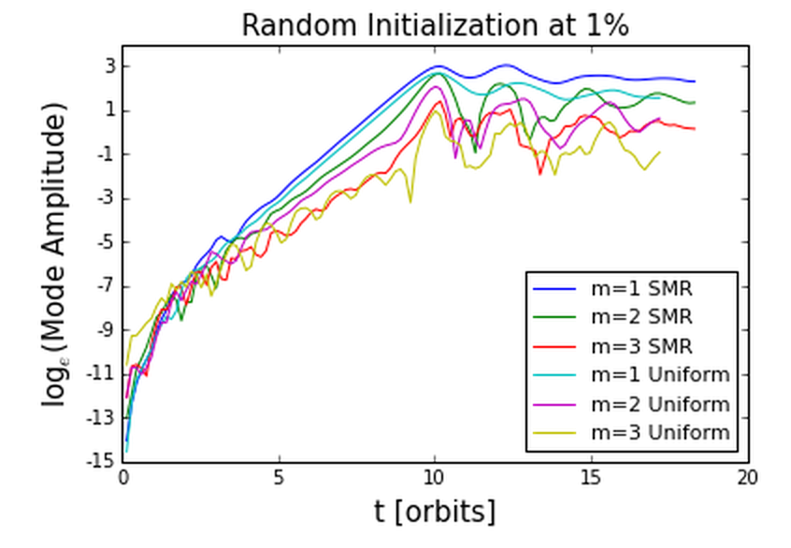
Comparison of
SMR and uniform grid
Notes:
SMR and Uniform grid result don’t exactly converge but qualitatively it looks the same.
The SMR is the more resolved one here
mode growth for m=1,m=2 compute the same
possibly: higher resolution means more higher modes resolved so the mode amplitude for the Uniform one is always slightly lower
this is already higher than previous resolution by a lot
but need to do a more comprehensive study to draw this conclusion

Slide 17
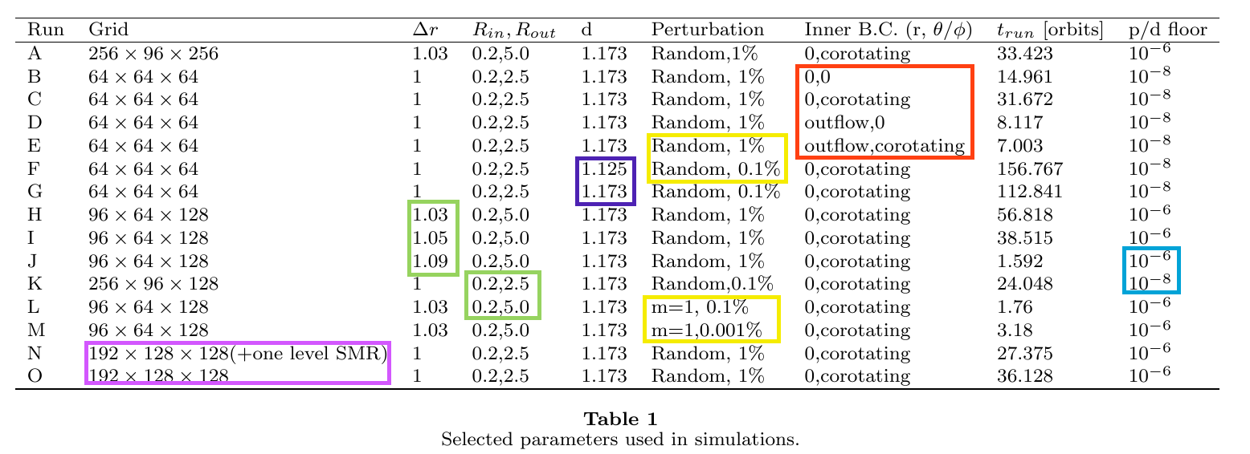
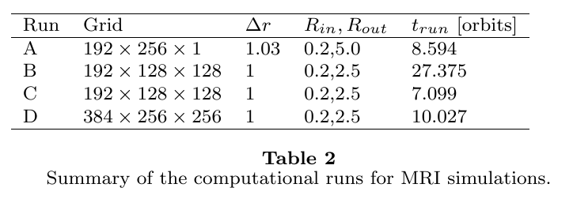
Effect of physical and numerical parameters for PPI
Notes:
- For the PPI case we conducted several sets of numerical experiment and picked the optimal parameters for use in MRI.
- Didn’t quite get to cover it in the slides, but happy to talk about this offline.

